Slide 1
Micro-Credit Defaulter Project
By
VANISREE P G

Slide 2
ACKNOWLEDGMENT
First I would like to thank the Almighty for his wonderful presence with me throughout this project and helped me to make it as a successful one. For my internship I had the pleasure of working at FILP ROBO Was a great chance for acquired knowledge, personal and Professional development. I extend whole hearted thanks to FILP ROBO under whom I worked and learned a lot and for enlightening me with their knowledge and experience to grow with the corporate working
This is a great pleasure to express my deep sense of gratitude and thanks to SME for his valuable ideas, instantaneous help, effective support and continued encouragement which enabled for the successful completion of the project. These are the following website which I referred for the references.
https://scikit-learn.org/
https://kaggle.com
www.google.com
www.geeksforgeeks.org

Slide 3
Business Problem Framing
A Microfinance Institution (MFI) is an organization that offers financial services to low income populations. MFS becomes very useful when targeting especially the unbanked poor families living in remote areas with not much sources of income.
The Microfinance services (MFS) provided by MFI are Group Loans, Agricultural Loans, Individual Business Loans and so on.
Many microfinance institutions (MFI), experts and donors are supporting the idea of using mobile financial services (MFS) which they feel are more convenient and efficient, and cost saving, than the traditional high-touch model used since long for the purpose of delivering microfinance services. Though, the MFI industry is primarily focusing on low income families and are very useful in such areas, the implementation of MFS has been uneven with both significant challenges and successes.
Today, microfinance is widely accepted as a poverty-reduction tool, representing $70 billion in outstanding loans and a global outreach of 200 million clients.

Slide 4
Motivation for the Problem Undertaken
This project includes the real time problem for Microfinance Institution (MFI), and it is related to financial sectors, as I believe that with growing technologies and Idea can make a difference, there are so much in the financial market to explore and analyze and with Data Science the financial world becomes more interesting.
The objective of the project is to prepare a model based on the sample dataset that classifies all loan defaulters and help our client in further investment and improvement in selection of customers.
The model will be a good way for the management to understand whether the customer will be paying back the loaned amount within 5 days of insurance of loan.
To understand real world problems where Machine Learning and Data Analysis can be applied to help to predict to make better decisions with the help of which they can gain profit or can be escaped from any loss which otherwise could be possible without the study of data.

Slide 5
Data Sources
Dataset provide by Flip robo Technologies Ltd. Micro Credit Defaulter dataset contain 209593 rows and 37 columns.
Build a model which can be used to predict in terms of a probability for each loan transaction, whether the customer will be paying back the loaned amount within 5 days of insurance of loan. I will start by importing all the necessary libraries that we need for this task and import the dataset.
1) Importing libraries
2) Importing the dataset
They are totally 209593 rows and 37 columns in a csvfile. Our target is to find the insights of the data and to do thorough data analysis.

Slide 6
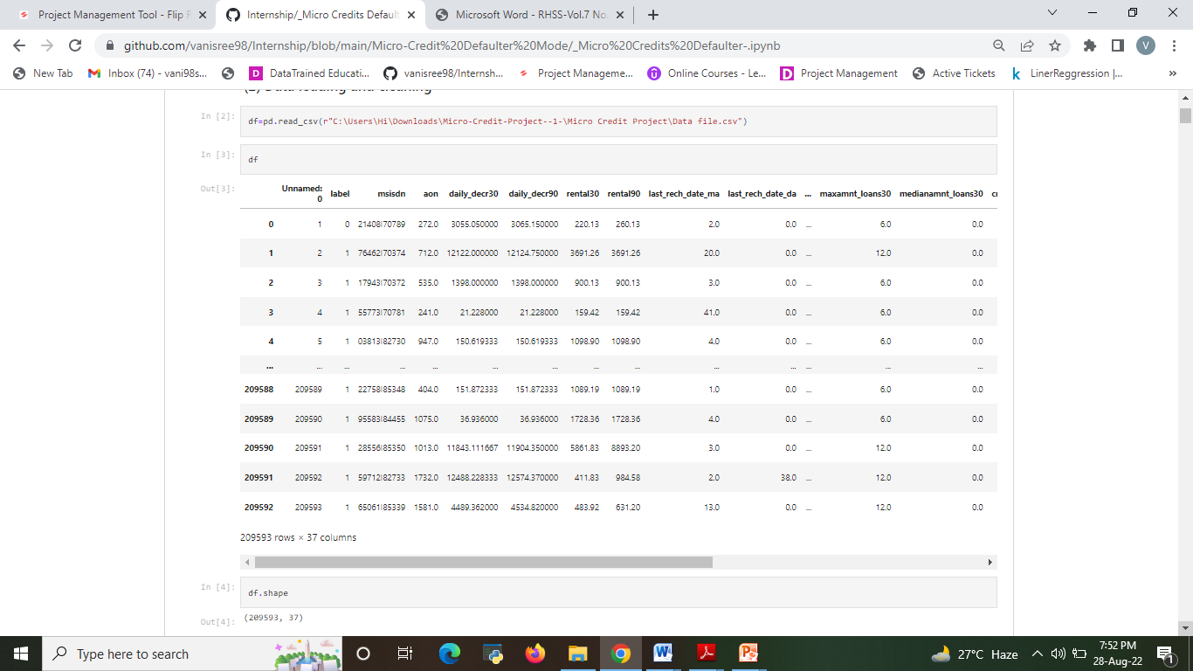

Slide 7
Data Pre-processing Done
The raw data is taken and performed various steps to reduce skewness, outlier, class imbalance and scaling. There were null value was present and removed the values from the dataset. Many outlier removal and skewness removal methods are tested and best method is chosen in order to prevent data loss.
The dataset contains totally 209593 rows and 37 columns
Label is our dependent variable.
Removing irrelevant columns
There are no null values in the dataset.
Converting all negative values to positive values in above columns
Removed empty cells.

Slide 8
MODEL BUILDING
Regression Model with following algorithms
Decision Tree Regression
Random forest regression
SVR
Kneighbors Classifier
Gaussian NB
Evaluation metrics
Accuracy score
Precision, recall
AUC,ROC
F1 score

Slide 9
Run and Evaluate selected models
Totally 5 models are performed
Kneighbors Classifier
Random forest regression
Decision Tree Classifier
Gaussian NB
SVC
Among that 3 models have been chosen and performed hyper parameter tuning.
Then those 3 models are evaluated using the evaluation metrics and the best model is chosen.
The best model is Random Forest with
Accuracy: 0.910923
Precision: 0.913728
Recall: 0.991495
F1 score: 0.951024

Slide 10
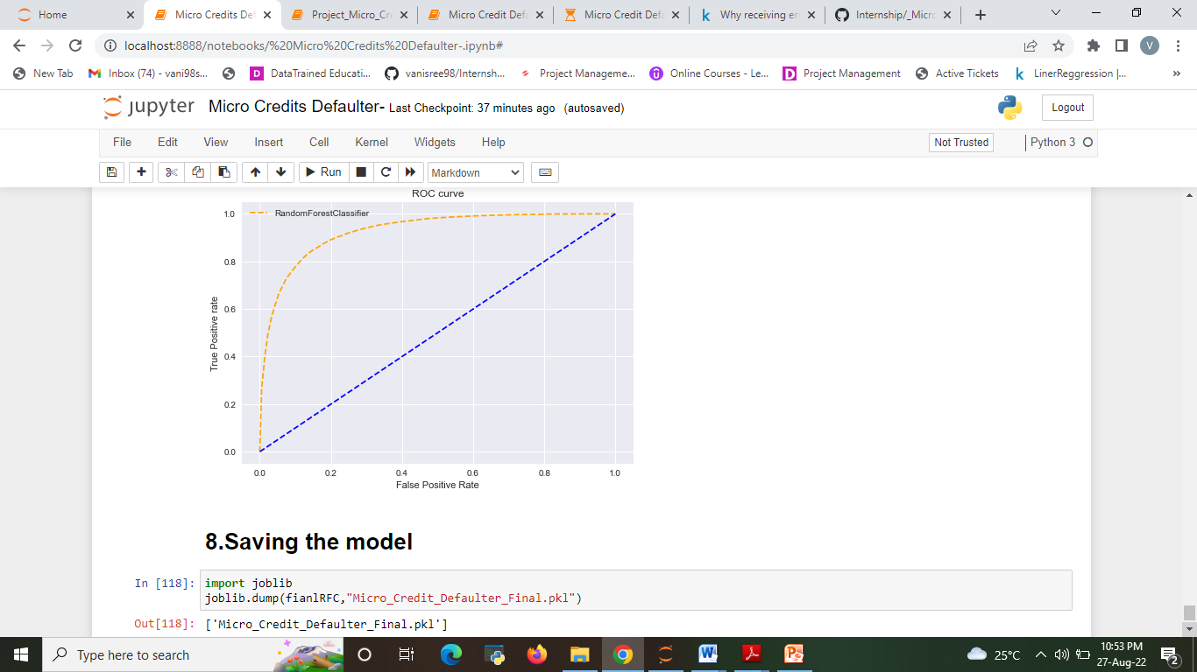
AOC -ROC CURVE OF ML MODELS

Slide 11
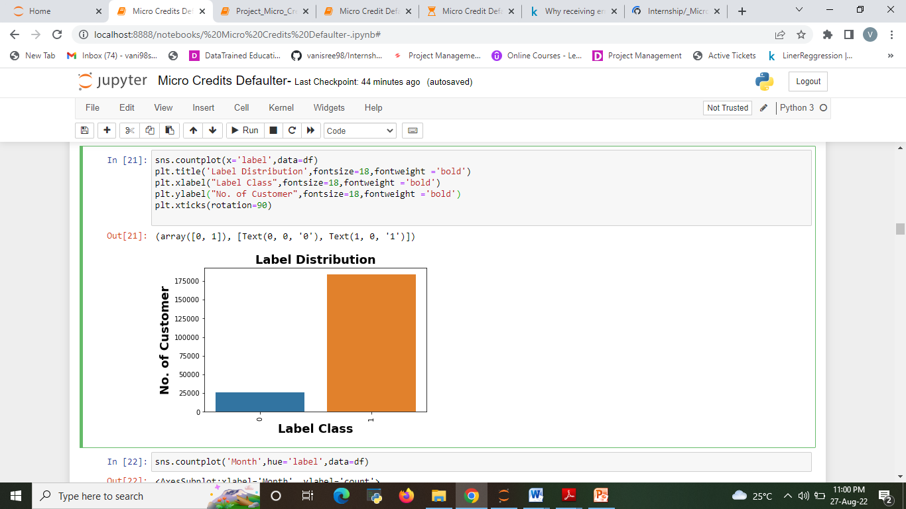
Visualizations
The Analysis of Label Distribution.
Here target variable Label class 1 represent non-defaulter while Label class 0 represent defaulter i.e., Loan not paid.
We can see Most of customers are non-defaulter while very few are defaulter

Slide 12
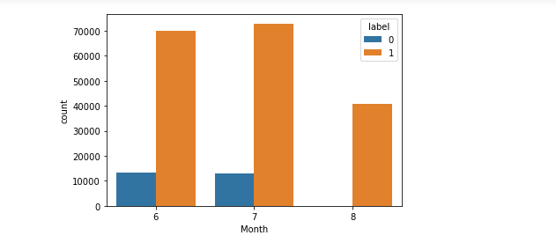
The Analysis of label based on month
Most of data belong to month 6 and 7, followed my month 8.
We can see very few defaulter in month 8.

Slide 13
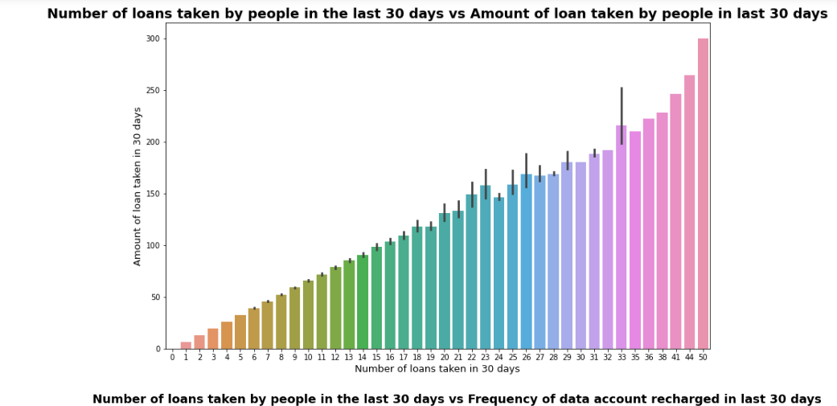
The Analysis of Number of loans vs Amount of loan
Maximum number of loans taken by the people is 50 and the Average loan amount is equivalent to 300.
Minimum number of loans taken by the people is 0.

Slide 14
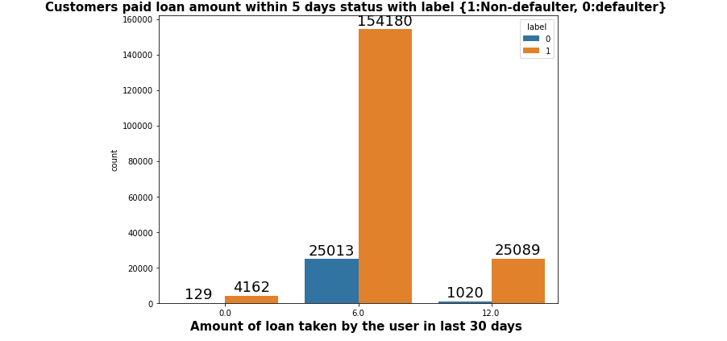
The Analysis of Amount of loan taken by the user in last 30 days.
Very few defaulter in customers who take loan in amount of 12.

Slide 15
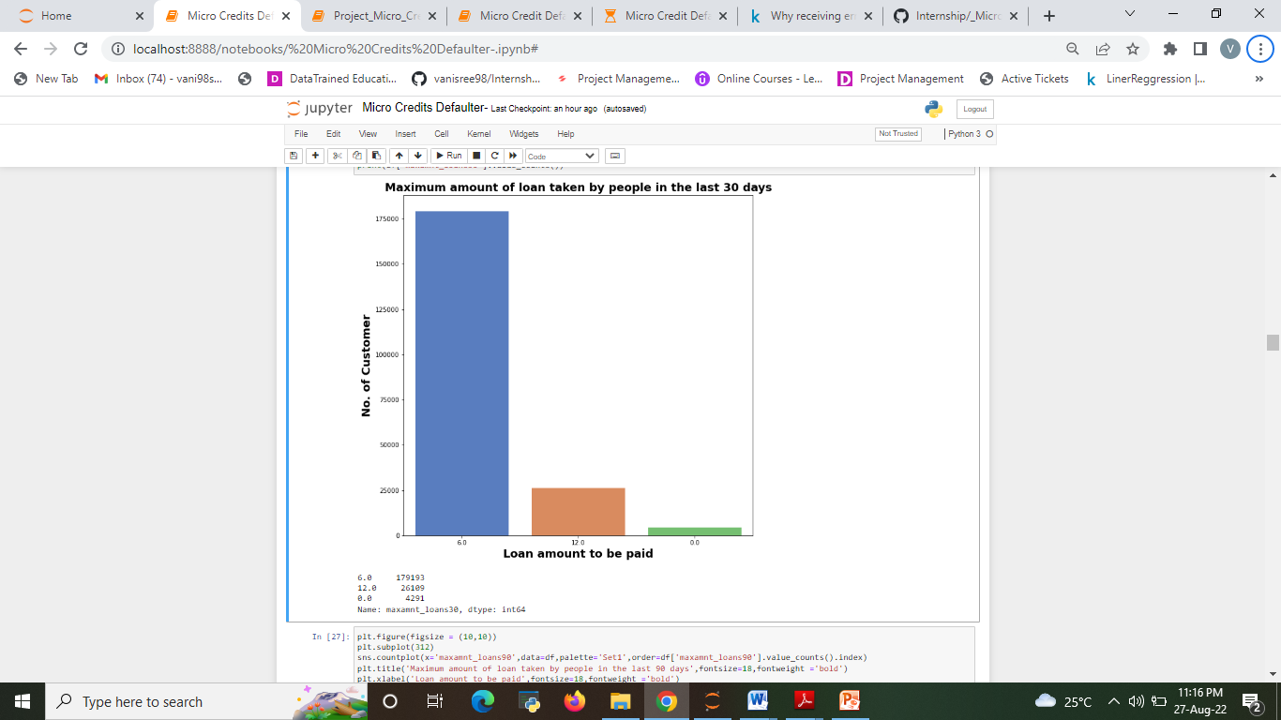
The Analysis of Maximum amount of loan taken by people in the last 30 days

Slide 16
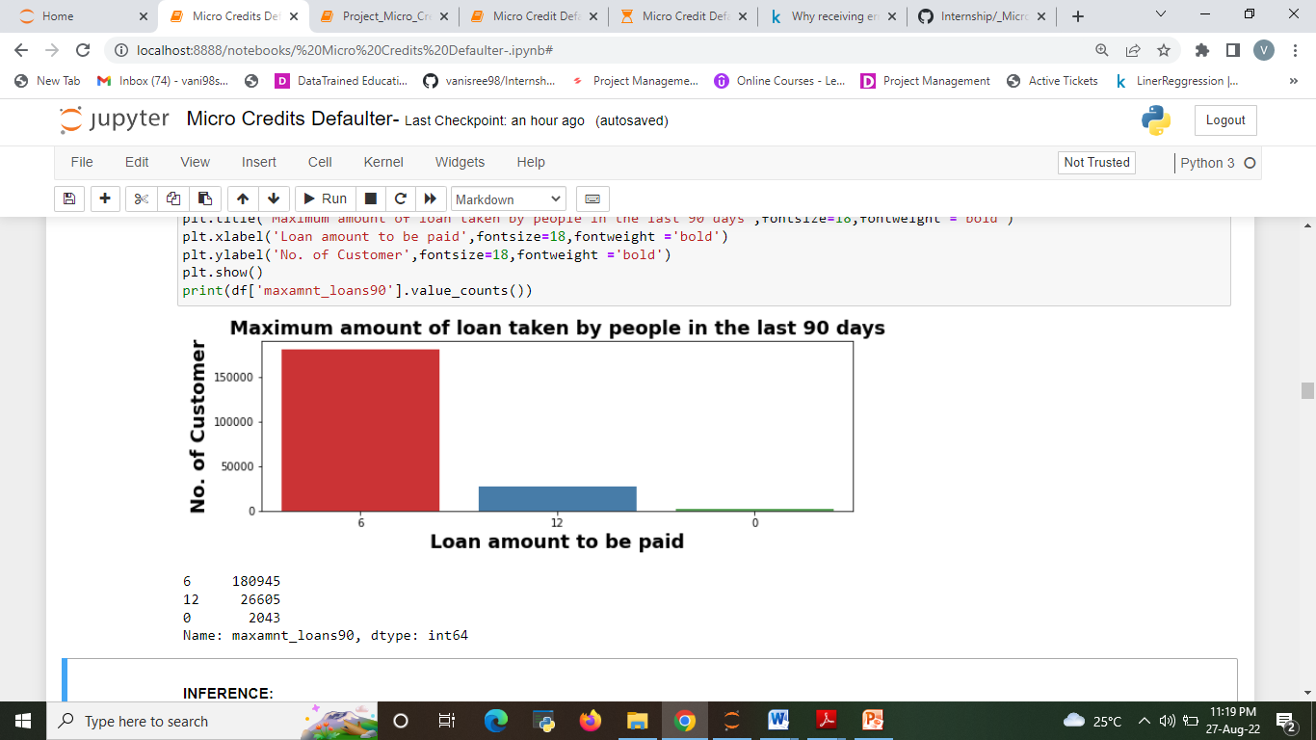
The Analysis Maximum amount of loan taken by people in the last 90 days

Slide 17
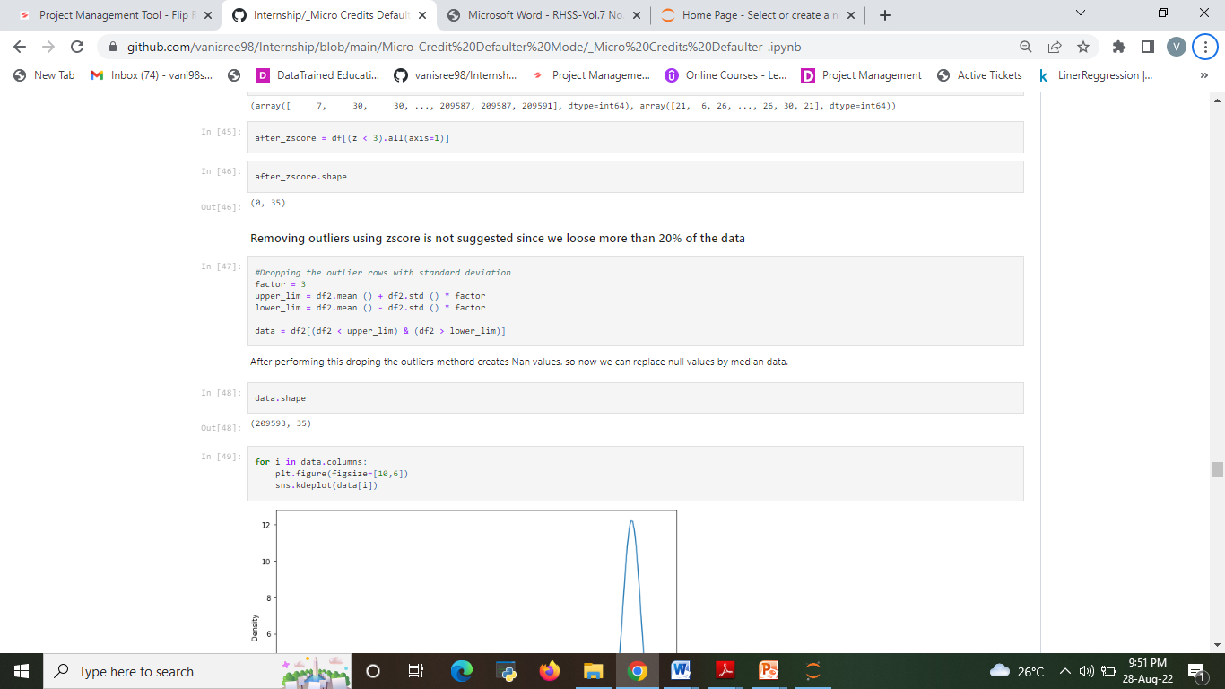
Feature Engineering
Outliers detection & removal
Z-score method results in huge data loss of 23.42 %, which we cannot afford.

Slide 18
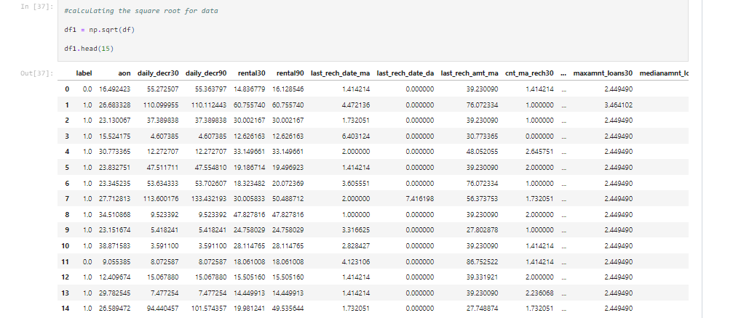
Checking and Removing Skewness
since the skewness is not reduced much in square root transformation again performing cube root transformation on same data

Slide 19
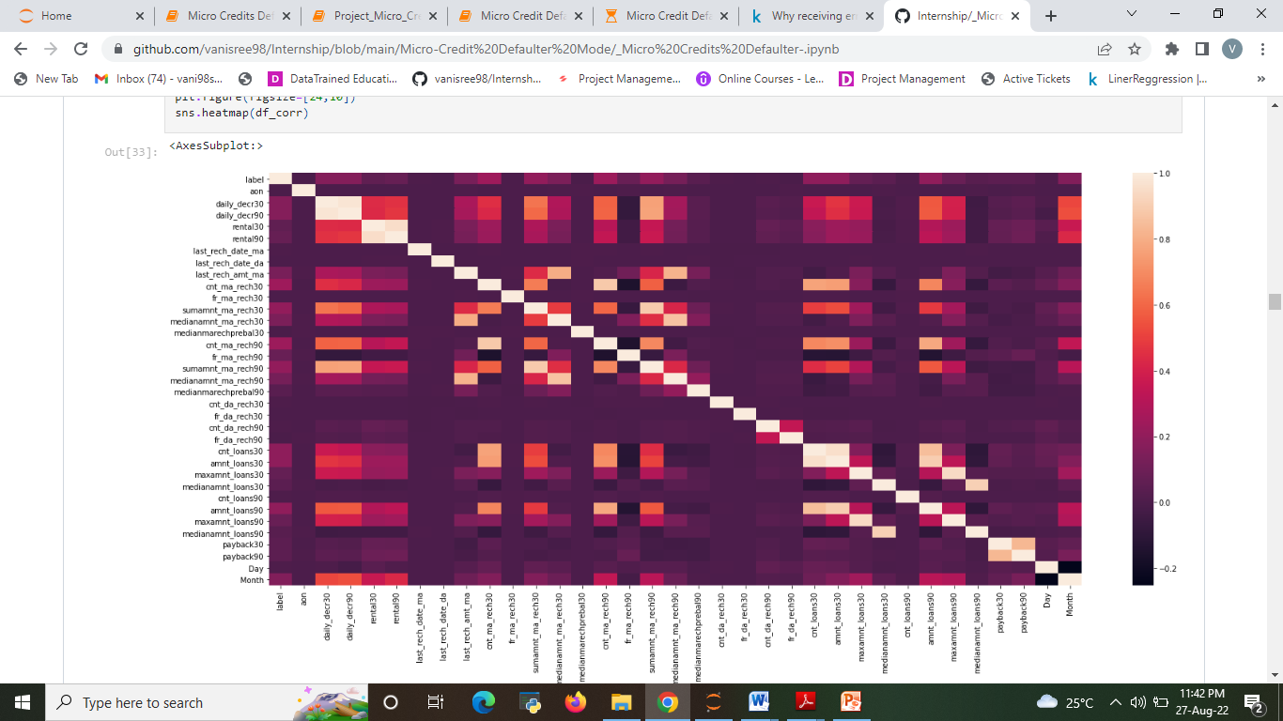
CORRELATION

Slide 20
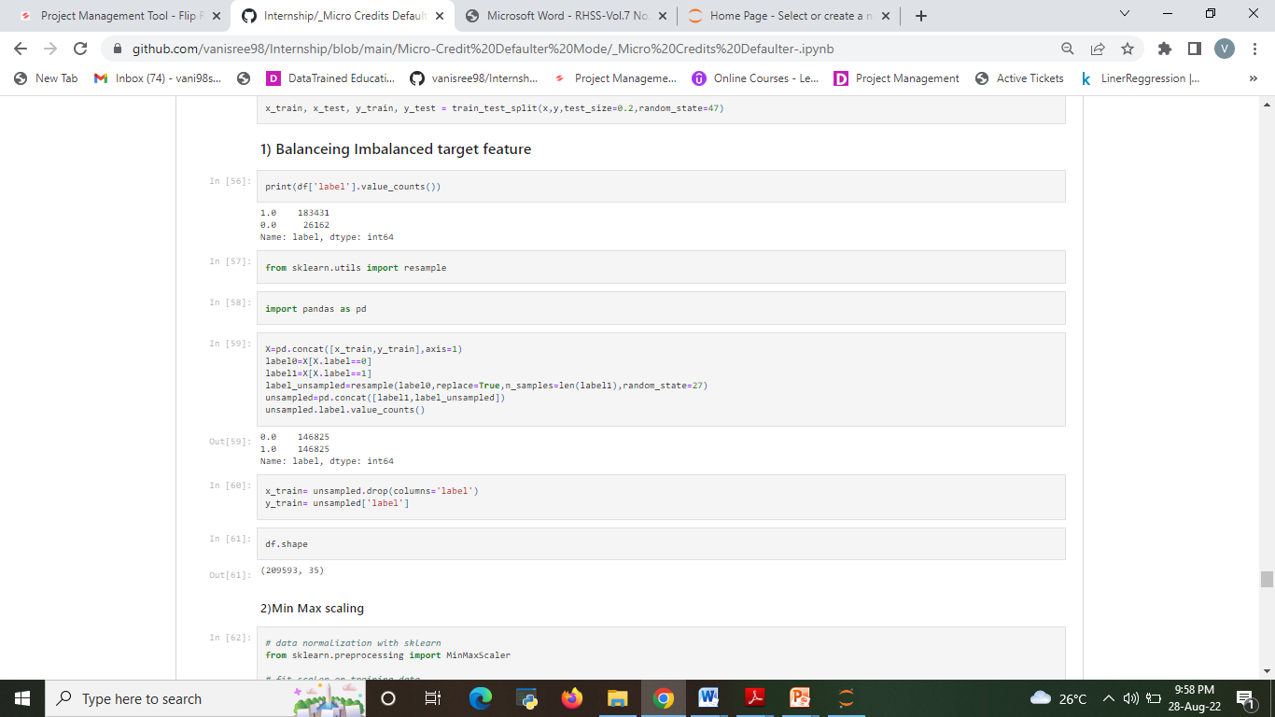
Handling IMBALANCED DATA
Target Variable label is Imbalanced in nature.
techniques used to oversample minority class.

Slide 21
Observations
Most importantly, the people are paying the amount early or lately and sometimes they might fail to pay within the time frame, but I observed that almost 80% of users are paying the amount within 7-8 days.
It is recommended that to extent loan repayment time frame from 5 days to 7 days.
The collected data is only for one Telecom circle area as per Dataset Documentation so that we had dropped that column.
Customer who takes a greater number of loans are non-defaulters (i.e., 98% of the category) as they repay the loan within the given time i.e., 5 days.
So here 'Decision Tree Classifier Model' is the best model out of all model tested above and by looking this we can conclude that our model is predicting around 92% of correct results for Label ‘0’ indicates that the loan has not been pay i.e. defaulter.
Tendency to pay loan within 5 days is high among customer who take loan many times within month compare to those who take loan 1-2 times.
It is recommended that to extent loan repayment time frame from 5 days to 7 days.

Slide 22
Conclusion
Microfinance has been globally accepted as the preferred medium to reach out to the rural and productive poor with banking services which includes micro credit to help alleviate poverty which is one of the United Nations millennium challenge goals.
Micro credit default has been identified to be one of the major drawbacks of this laudable initiative as it depletes these revolving funds and reduces investors’ confidence.
Therefore, it is important to understand the factors that influence a loan beneficiary to default so that appropriate countermeasures can be developed to prevent and reduce the incidents of default.

Slide 23
Limitations and Scope
The techniques to increase the speed of the model need to be constructed. In Upcoming days when huge amount of information is accessed as in detailed information in the dataset, the expected results in future are highly correct. For further research anyone desire to expand upon it ought to request different sources of historical data or be a lot of organized in collection knowledge manually over amount of your time to boot.
The techniques to increase the speed of the model need to be constructed. The future model can be constructed with the most co related data with the target variable in order to increase the speed of the model.

Slide 24
THANK YOU

